Slide 1

Helmet Detection for Vehicle Ignition and riding, A Click for Safety
DEPARTMENT OF INFORMATION TECHNOLOGY
Batch-05
Review-04
Under the Esteemed Guidance of
Mrs. A.S.DHANALAKSHMI, M.Tech.,
Assistant Professor
Team Members
K. RAM SAI - 20T91A1217
K. MADHAVA - 20T91A1210
N. THRINADH CHOWDARY - 20T91A1231
GIET ENGINEERING COLLEGE
Accredited by NAAC, Affiliated to JNTUK, Kakinada, Chaitanya Knowledge City, Velugubanda, Rajamahendravaram – 533 296,Andhra Pradesh, India.
2023-2024

Slide 2
Helmet Detection for Vehicle Ignition and riding
A Click for Safety
USING DEEP LEARING AND IMAGE PREPROCESSING

Slide 3
Contents
Abstract
Introduction
Existing system with limitations
Proposed system with advancements
Requirements of software and hardware
Modules
UML Diagrams
Codes
Screenshots
Conclusion
Reference

Slide 4
Abstract
Problem: Motorcycle accidents are a leading cause of death and injury, often due to head trauma. Helmets significantly reduce this risk, but compliance with helmet laws can be inconsistent.
Solution: We propose a helmet detection system for vehicle ignition and riding that leverages computer vision and machine learning to ensure riders wear helmets before starting their motorcycles.
Methodology: Cameras or sensors near the driver's seat capture head area data. If a helmet is detected, the ignition is enabled. If not, an alert or immobilization mechanism is triggered.
Keywords: Motorcycle safety, helmet detection, computer vision, machine learning, artificial intelligence.
26/03/2024

Slide 5

Introduction
The promise of helmet detection technology for vehicle ignition a system that ensures your ride starts only when you're safely helmeted.
This innovative technology leverages computer vision and deep learning to detect the presence of a helmet on the rider’s head.

Slide 6

Existing system with limitations
Helmet detection technology for vehicle ignition holds immense promise for improving motorcycle safety. While the concept is relatively new, several systems have emerged in recent years, each with its unique features and limitations. Here's a breakdown of some notable examples : TVS IntelliGO (India), Bajaj Pulsar RS200 (India)
Limitations:
Adds extra cost and complexity to the riding experience, requires installation and ongoing maintenance.
User acceptance

Slide 7

Proposed system with advancements
The proposed system takes helmet detection technology to the next level, aiming to create a comprehensive safety ecosystem for motorcycle riders. By leveraging advanced technology and fostering data-driven safety initiatives.
Enhanced accuracy and robustness
Personalized safety profiles
Telematics integration

Slide 8

Requirements
Software
Windows OS(minimum Windows 10)
Programming Language : Python 3.8.0 or higher
Arduino IDE
Open CV
YoloV3 Algorithm
Numpy
Pandas
Tensorflow
Hardware
Arduino UNO board
Camera Module
Buzzer
Standard Peripherals
Processor : Dual core or higher

Slide 9
Modules
Helmet Detection:
Import Libraries
Initialize serial part for communication with Arduino
Drawing predicted bounding box for camera
Removing the bounding box with low confidence using non- maxima suppression
26/03/2024

Slide 10
Modules
Perform non-maximum suppression to eliminate redundant overlapping boxes with lower confidences
My_class : ’Helmet’<if
Recognizing face Predict->
Helmet detected / Not detected

Slide 11

UML Diagrams

Slide 12
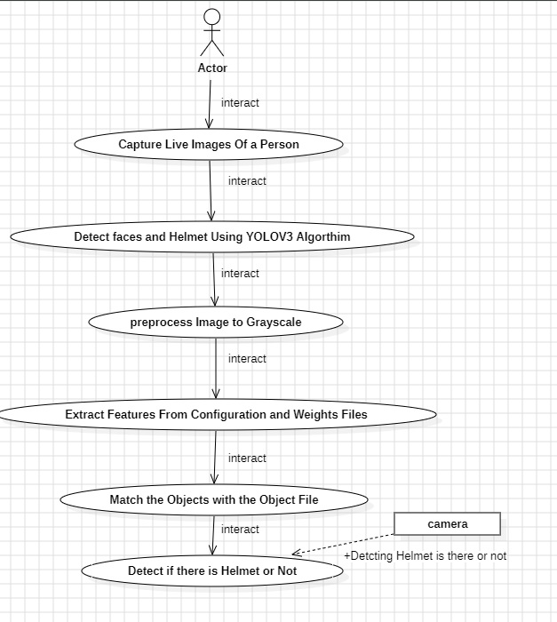
Usecase diagram

Slide 13
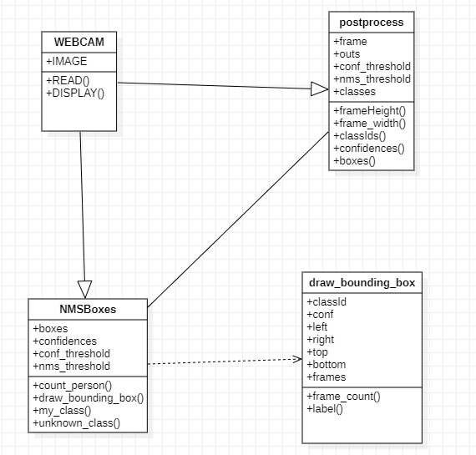
Class diagram

Slide 14
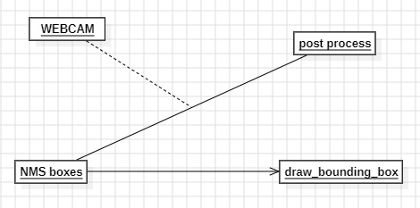
Object diagram

Slide 15
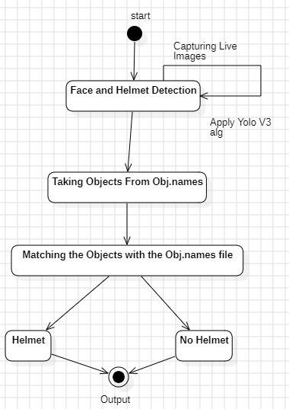
State diagram

Slide 16
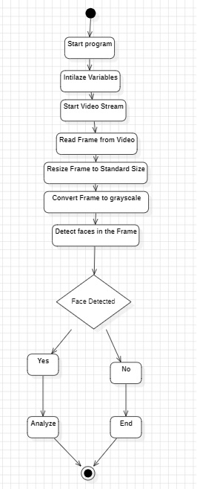
Activity diagram

Slide 17
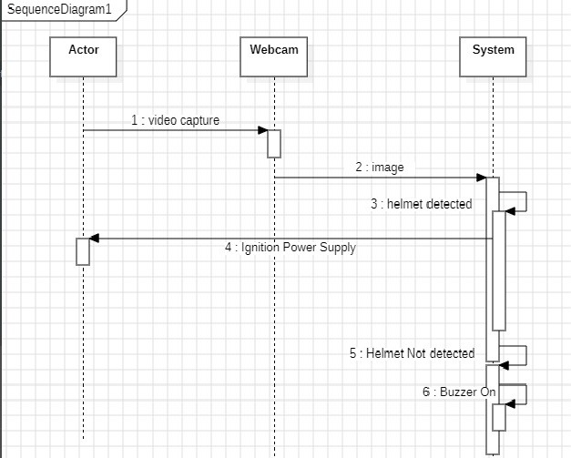
Sequence diagram

Slide 18
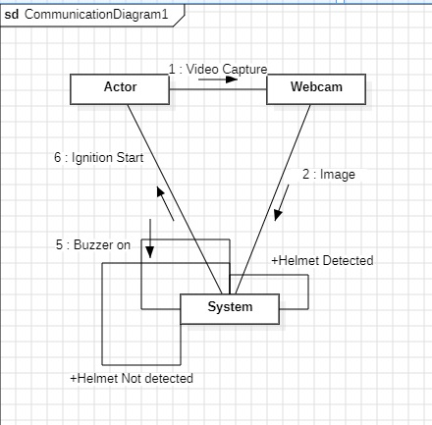
Collaboration diagram

Slide 19
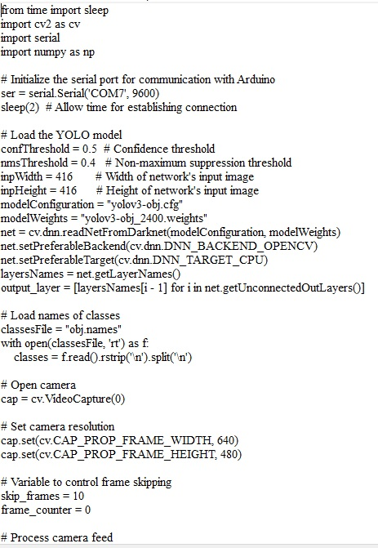
CODES
send.py

Slide 20
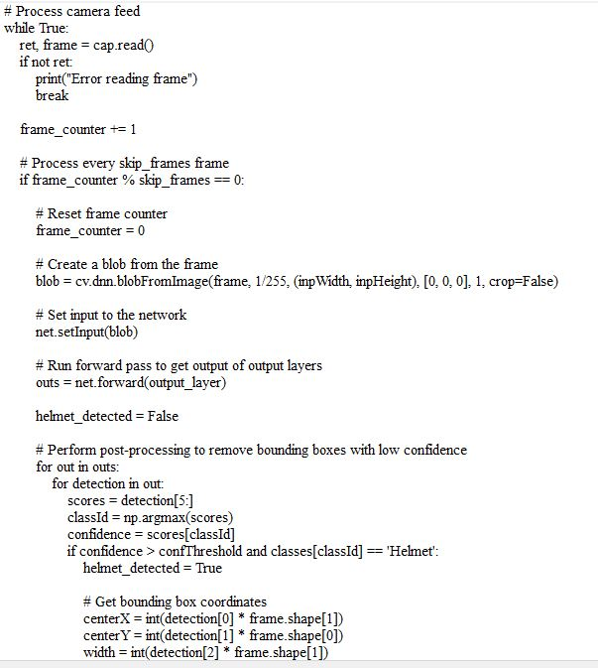

Slide 21
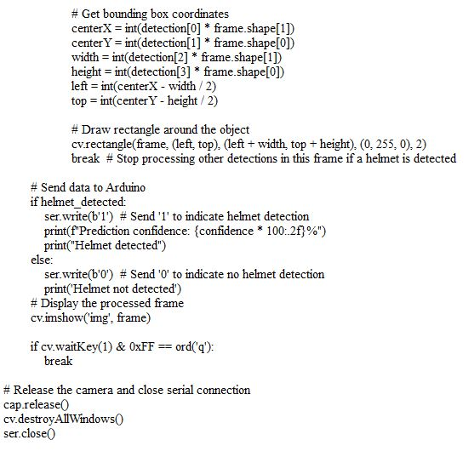

Slide 22
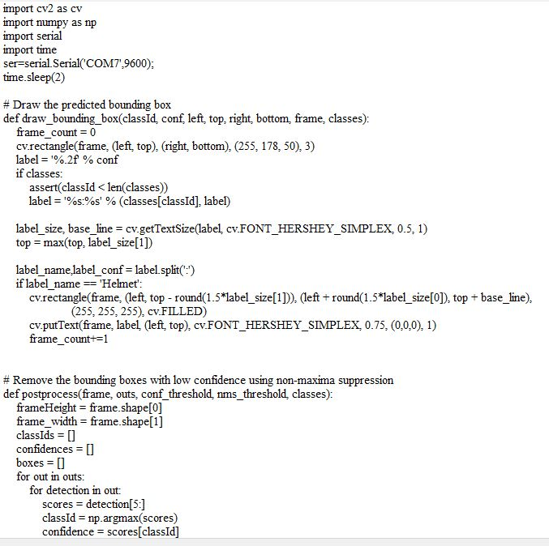
Utils.py

Slide 23
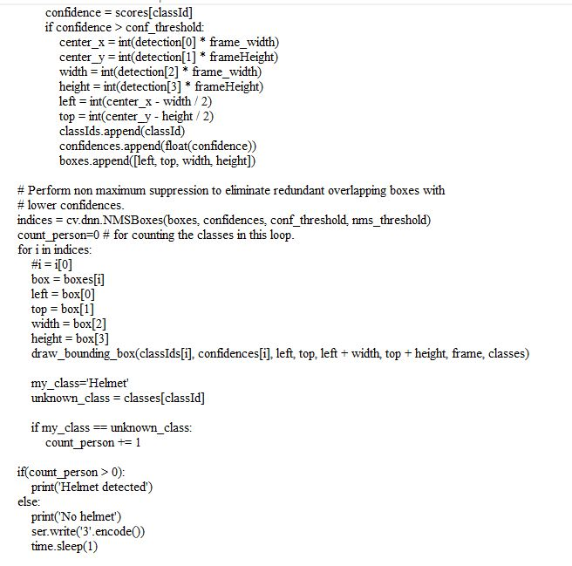

Slide 24

smart_helmet_withBuzzer_LEDS.C

Slide 25
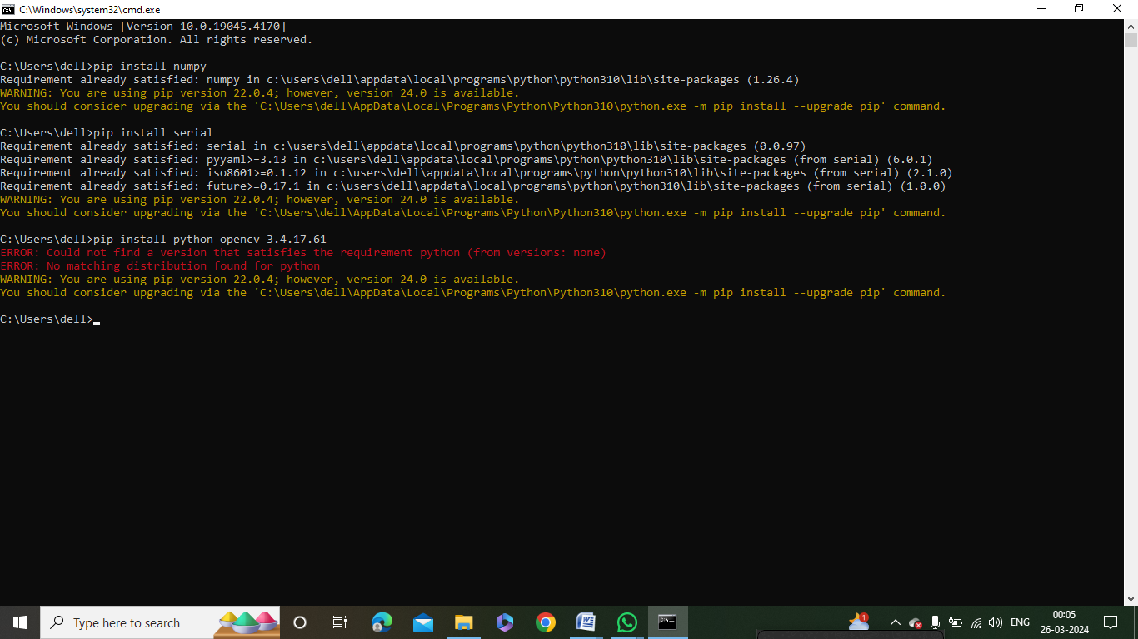
Screenshots
Libraries Installation

Slide 26
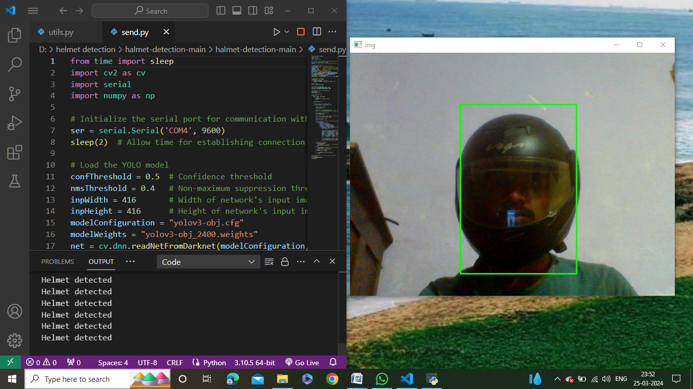
Output Screen 1

Slide 27
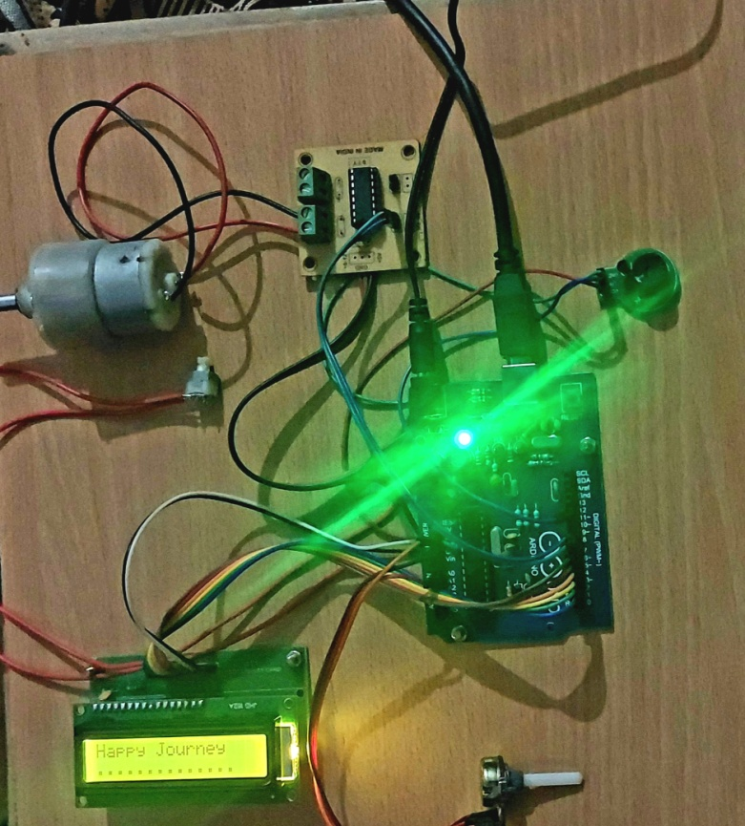
Display Text of Output 1

Slide 28
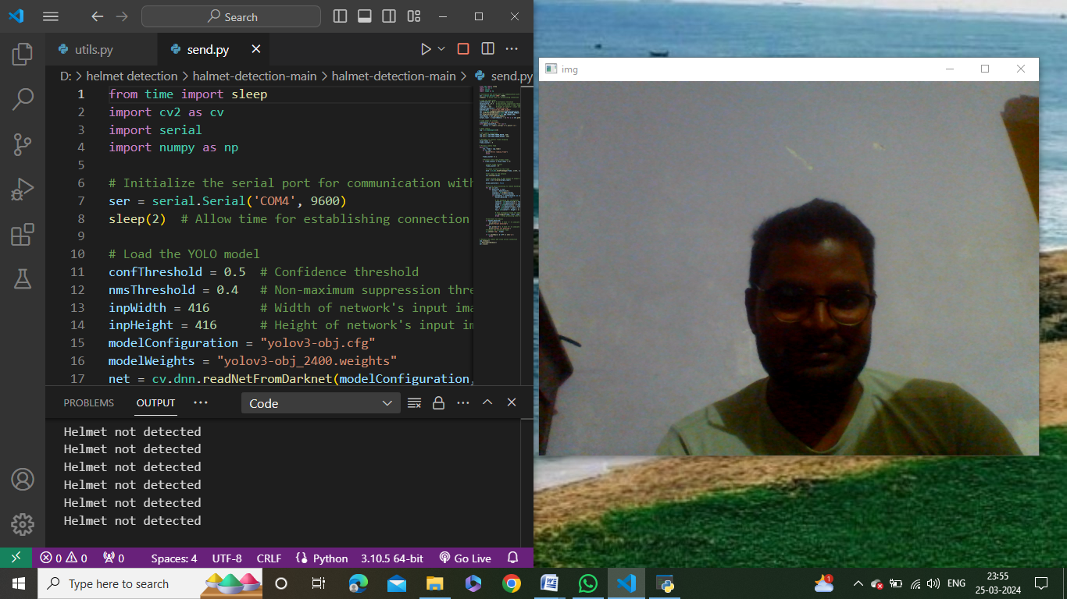
Output Screen 2

Slide 29
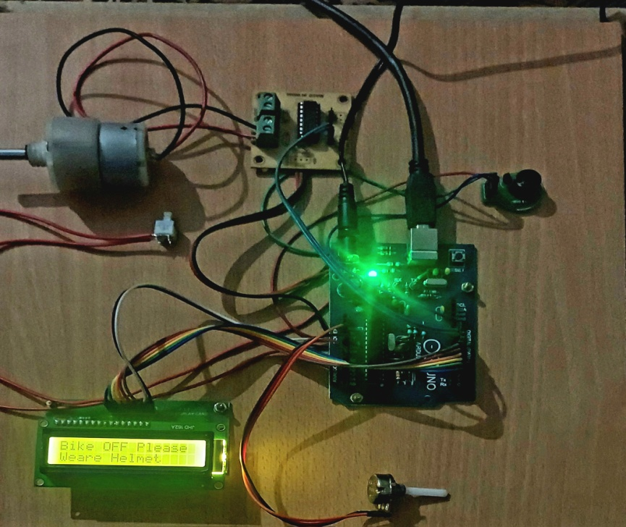
Display Text of Output 2

Slide 30
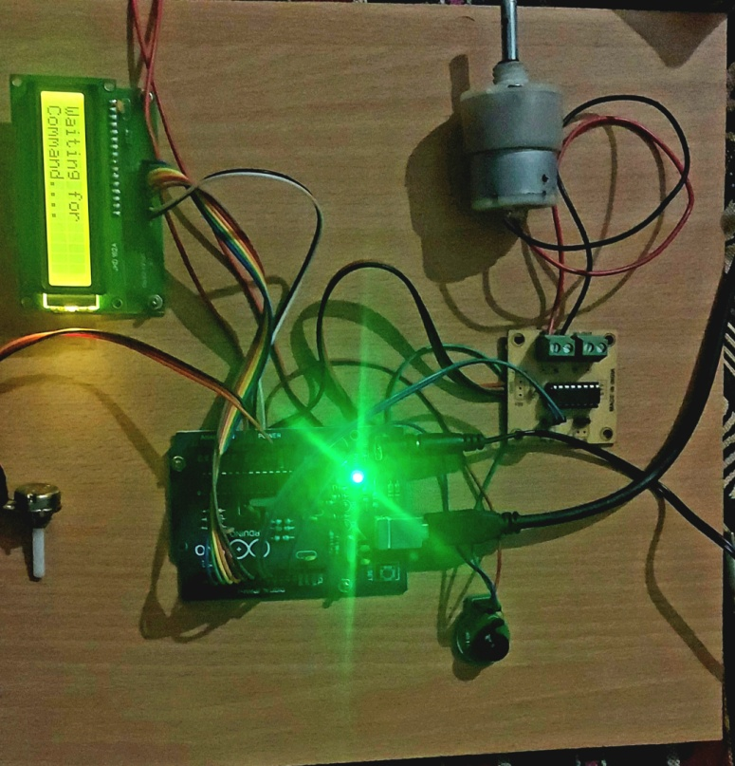
Prototype IDLE State

Slide 31
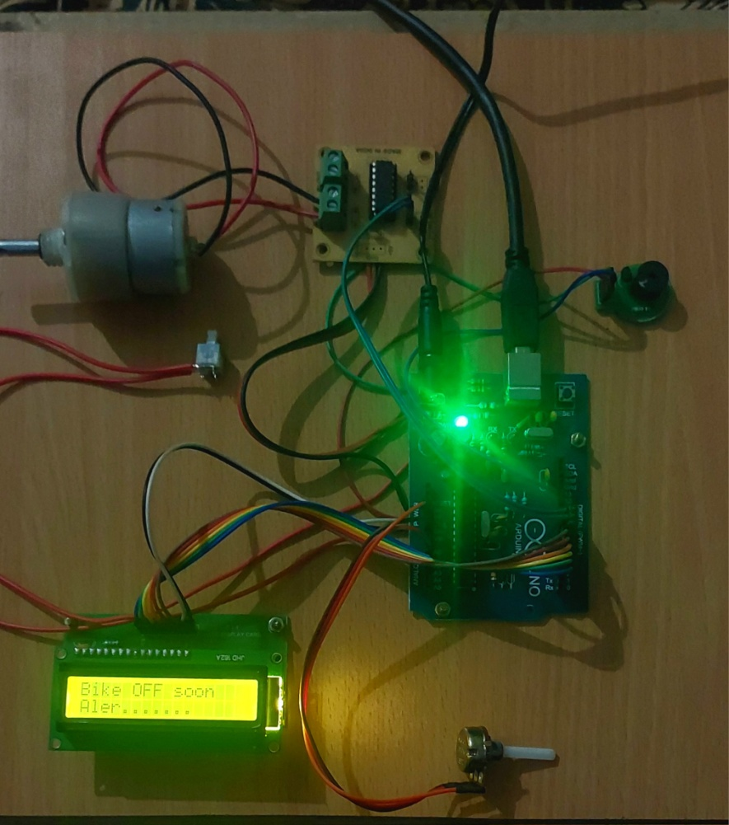
Display of Emergency State

Slide 32

Conclusion
Our helmet detection system for vehicle ignition presents a significant leap forward in motorcycle safety. By harnessing the power of AI, we propose a practical and reliable solution to the persistent challenge of ensuring helmet usage.
Reduced head injuries and fatalities
Enhanced legal compliance
Increased rider confidence
26/03/2024

Slide 33

Reference
https://www.who.int/travel-advice
https://dea.gov.in/
https://morth.nic.in/
K.C. Mani Kulanthayan, Hui Fang Teow, Hari Krishnan Tamil Selvan, Kaviyarasu Yellappan and Vaidehi Ulaganathan 2020 “Determinants of standard motorcycle safety helmet usage among child pillion riders”, Transportation Research, 74, pp 408 – 417.
Bolbol S.A and Zalat M.M 2018 “Motorcycle riders’ risky behaviours and safety measures: a hospital-based study”, Egyptian Journal of Occupational Medicine 42 (3): 453-468 [2] World health statistics 2008
26/03/2024

Slide 34

26/03/2024

Slide 35

26/03/2024

